Slide 1
HOUSE PRICE
PREDICTION
Machine Learning Regression Project
• Student Name: KANIKA ORAON
• Roll / Enrollment No.: A35404825022
• Course / Class: BCA
• Institution: AMITY UNIVERSITY JHARKHAND
• 17,000 records • 4 models

Slide 2
Problem Statement
02
What real-world problem is being addressed?
The challenge
ML solution
Why it matters
House prices depend on geographic, demographic and housing characteristics, making manual estimation difficult.
Learn relationships from historical housing data and use them to estimate median house value.
A consistent prediction model can support quicker, data-driven property valuation.
• This is a regression problem because the target is a continuous numeric value.
• Target variable: median_house_value.
• The project compares four regression models.
House Price Prediction

Slide 3
Project Objective
03
What the system is designed to predict
Primary objective
Model objective
Predict median house value using the eight available input features.
Compare Linear Regression, Random Forest, Gradient Boosting and ANN using MAE, RMSE and R².
• Inspect and understand the dataset.
• Perform EDA and identify useful relationships.
• Prepare train/test data and scale features where used.
• Train four models and evaluate them on the test set.
• Select the best-performing model.
House Price Prediction

Slide 4
Dataset Description
04
California Housing training data used in the notebook
Rows
Columns
Features
Target
17,000
9
8
median_house_value
• Input features:
• longitude
• latitude
• housing_median_age
• total_rooms
• total_bedrooms
• population
• households
• median_income
• Target: median_house_value
• All 9 columns are numeric (float64).
• Target mean: $207,300.91
• Target range: $14,999–$500,001
House Price Prediction

Slide 5
Data Preprocessing
05
Preparation steps actually used in the notebook
1
Separate X and y
X = 8 input features; y = median_house_value.
2
Train/test split
80% training and 20% testing with random_state=42.
3
Feature scaling
StandardScaler fitted on training data and applied to train/test.
4
Missing-value check
Notebook reports 0 missing values in all columns.
No explicit duplicate removal, outlier handling, encoding or feature engineering step is shown in the notebook.
House Price Prediction

Slide 6
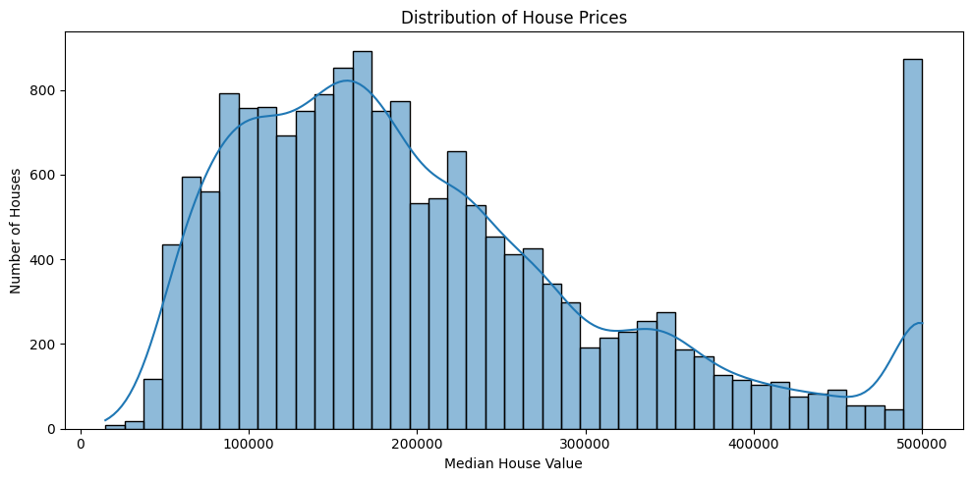
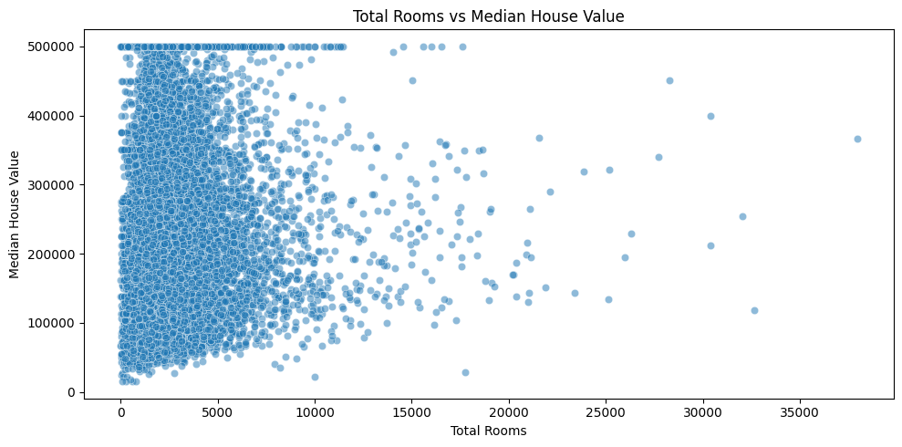
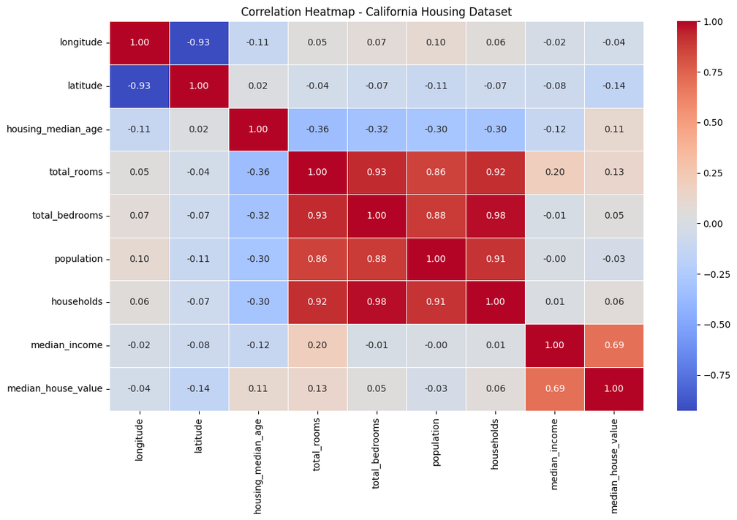
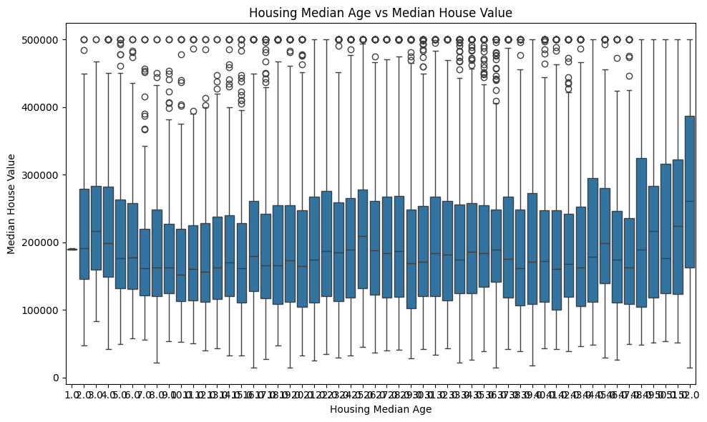
EDA & Visual Insights
06
Four meaningful graphs from the notebook
House prices show a broad distribution with an upper tail.
More rooms generally relate to higher values, but the relationship is scattered.
Median income has a strong visible relationship with house value.
House value varies substantially across housing-age groups.
House Price Prediction

Slide 7
ML Methodology
07
End-to-end workflow from dataset to prediction
Dataset
Prepare
Scale
Train
Evaluate
Select
17,000 × 9
X/y + 80:20
StandardScaler
4 models
MAE • RMSE • R²
Random Forest
• MAE and RMSE measure prediction error; lower is better.
• R² measures explained variance; higher is better.
• The held-out test set is used for final comparison.
House Price Prediction

Slide 8
Models Implemented
08
Algorithms used and one-line explanation
Linear Regression
Random Forest Regressor
Baseline linear model using scaled features.
Ensemble of decision trees for non-linear relationships.
Gradient Boosting Regressor
ANN – Deep Learning
Sequential trees that reduce prediction error.
Dense neural network with ReLU layers and dropout.
• Random Forest: 100 estimators, random_state=42.
• Gradient Boosting: 100 estimators, learning_rate=0.05, max_depth=3.
• ANN: 128 → 64 → 32 → 1, dropout=0.2, 50 epochs.
House Price Prediction

Slide 9
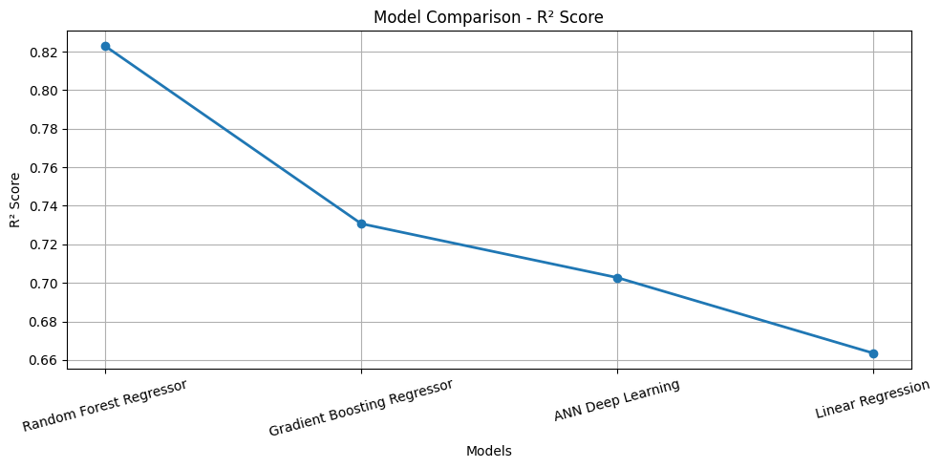
Model Evaluation
09
Comparison on the test set
Model
MAE
RMSE
R²
BEST MODEL
Random Forest Regressor
$32,360
$49,415
Random Forest Regressor
R² = 0.823
MAE ≈ $32,360
RMSE ≈ $49,415
Highest R² and lowest errors.
0.823
Gradient Boosting Regressor
$43,307
$60,911
0.731
ANN Deep Learning
$44,831
$63,993
0.703
Linear Regression
$49,983
$68,078
0.664
Random Forest clearly leads the four-model comparison.

Slide 10
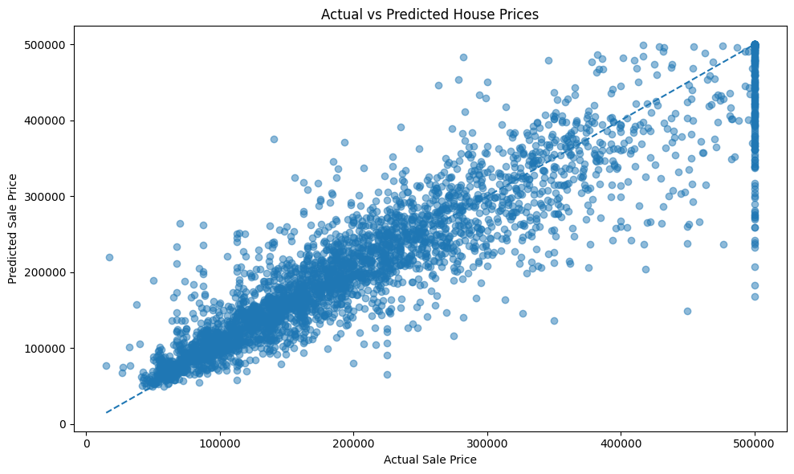
Prediction Demo
10
Actual vs predicted values from the Random Forest model
What the plot shows
Points closer to the diagonal represent predictions closer to the actual house value.
Notebook result
The notebook does not provide a single manual user-input example, so this slide uses the recorded test-set prediction plot rather than inventing an example.
Model: Random Forest Regressor • Prediction array: rf_pred
House Price Prediction

Slide 11
Results, Conclusion & Limits
11
Main findings, learning and current limitations
Key finding
What was learned
Limitation
Random Forest achieved the best recorded performance: R² = 0.823.
Ensemble tree models captured the dataset relationships better than the linear baseline in this comparison.
Predictions still contain meaningful error, so the model should not be treated as exact valuation.
• No explicit outlier, duplicate, encoding or feature-engineering workflow is shown.
• The notebook records overflow warnings around an np.expm1 price-conversion step; the main evaluation compares y_test directly with model predictions.
• There is no deployed application or single manual-input prediction example in the notebook.
House Price Prediction

Slide 12
Future Scope & GitHub
12
Possible improvements plus repository sharing
• Add systematic outlier analysis and feature engineering.
• Tune hyperparameters with cross-validation.
• Explore stronger ensembles and better-tuned neural networks.
• Build a simple web interface for user-entered predictions.
• Add feature-importance / SHAP explainability.
• Validate the model on an independent dataset.
GitHub / QR Code
The notebook does not contain a repository link. Add the final GitHub URL or QR code here before submission.
Final checklist
Replace title-slide placeholders with your name, roll number, course/class and institution.

Slide 13
THANK YOU

